Slide 1
SOLID PRINCIPLES Assignment

Slide 2
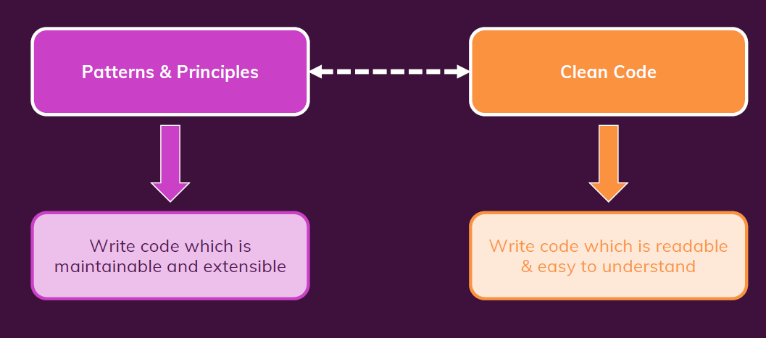
Clean Code and Principle Patterns

Slide 3
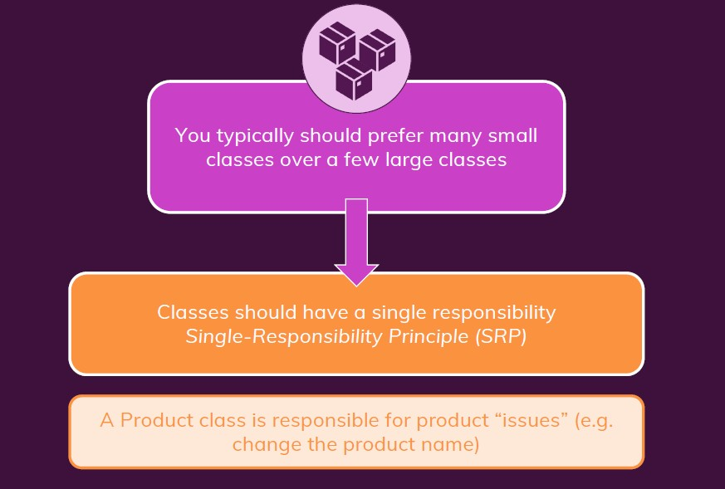
Classes should be small

Slide 4
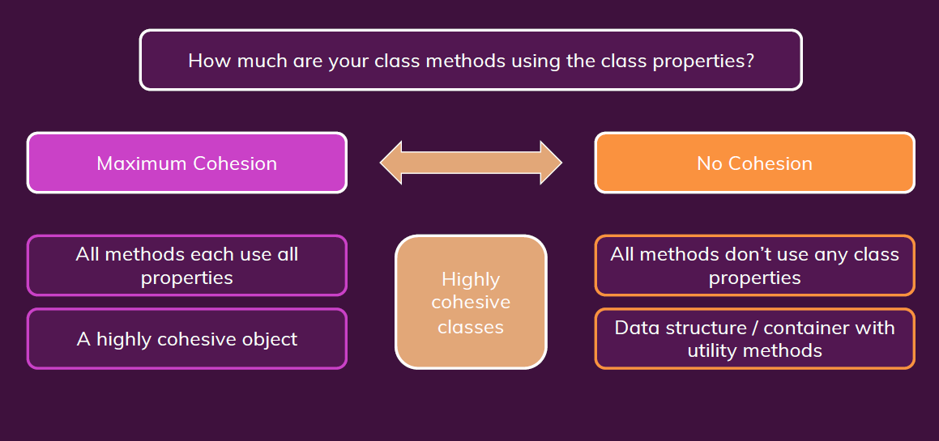
Cohesion

Slide 5
Cohesion

Slide 6
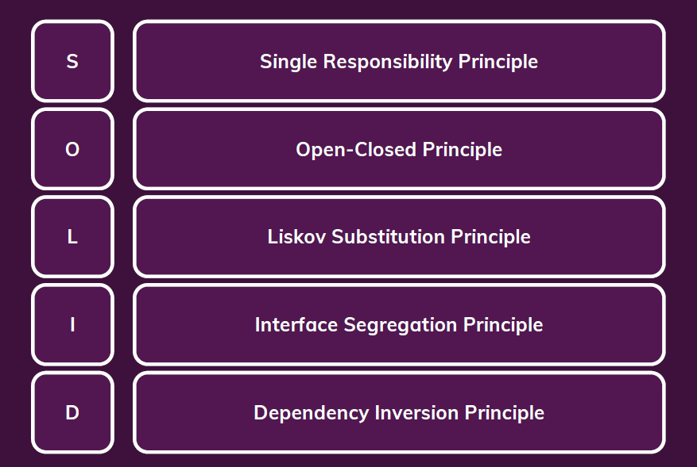
SOLID PRINCIPLES

Slide 7
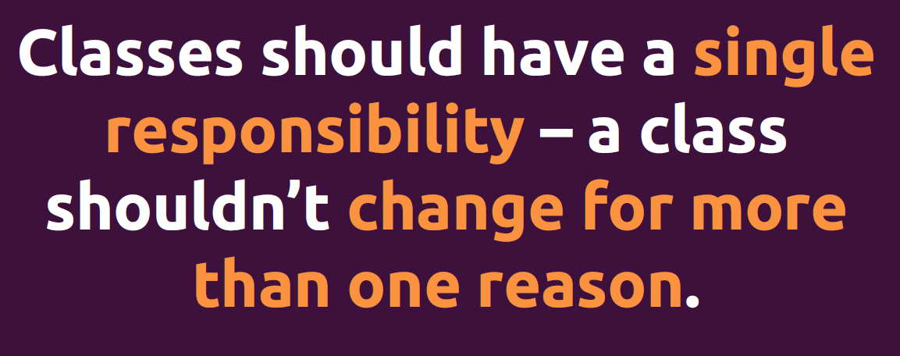
Single Responsibility Principle

Slide 8
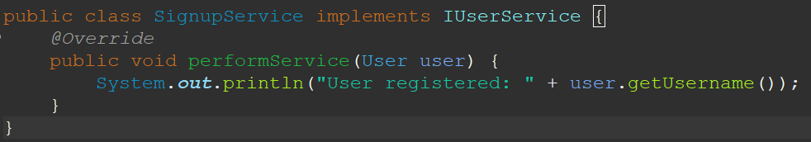
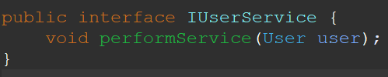
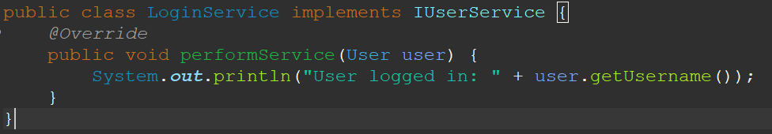
Single Responsibility Principle
Class SignupService implements IUserService
Interface IUserService
Class SignupService implements IUserService

Slide 9
Single Responsibility Principle
The class SignupService is responsible for user registration, and the class LoginService is responsible for user login. This shows that the classes follow the SRP as each class has a specific responsibility.

Slide 10

Open Closed Principle

Slide 11
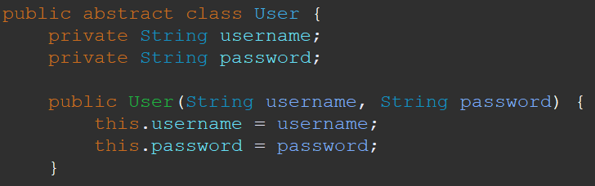
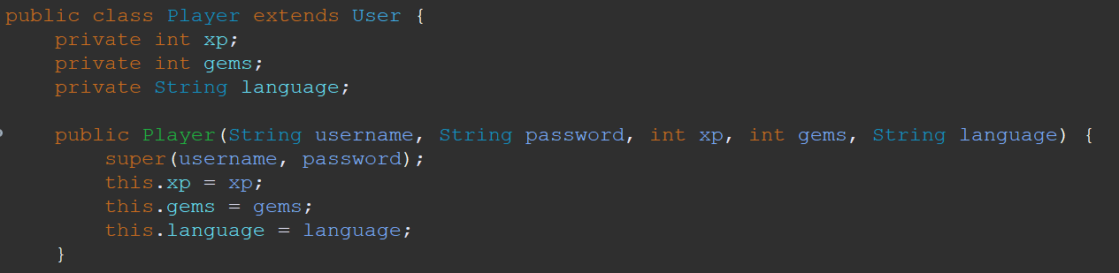
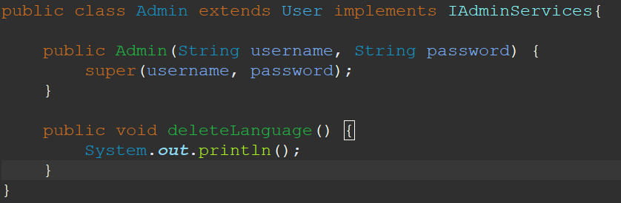
Open Closed Principle
Class User
Class Player which extends User
Class Admin which also extends User

Slide 12
Open Closed Principle
The Player class follows the Open/Closed Principle because it extends the User class without modifying its source code. It adds new attributes (xp, gems, language) and methods(deleteLanguage() for admin) related to user-specific functionality. This allows for extension without altering the existing User class.

Slide 13
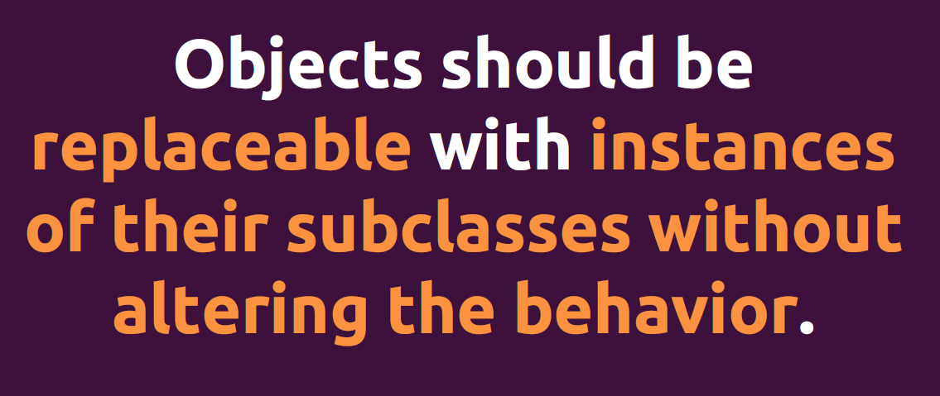
Liskov Substitution Principle

Slide 14
Liskov Substitution Principle
Class User
Class Player which extends User
Class Admin which also extends User

Slide 15
Liskov Substitution Principle
The Player class, which extends User adheres to the LSP. Objects of the Player class can be used wherever objects of the User class are expected.

Slide 16
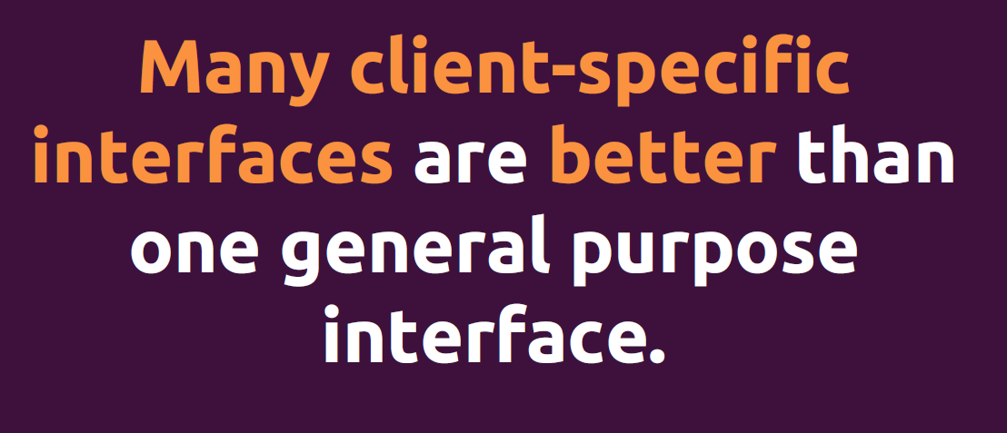
Interface Segregation Principle

Slide 17



Interface Segregation Principle
Interface IUserService
The interfaces (IAdminServices, IUserService, IPasswordResetService) are segregated properly. Each interface has a specific set of methods related to its responsibility.
Interface IAdminServices
Interface IPasswordResetServices

Slide 18
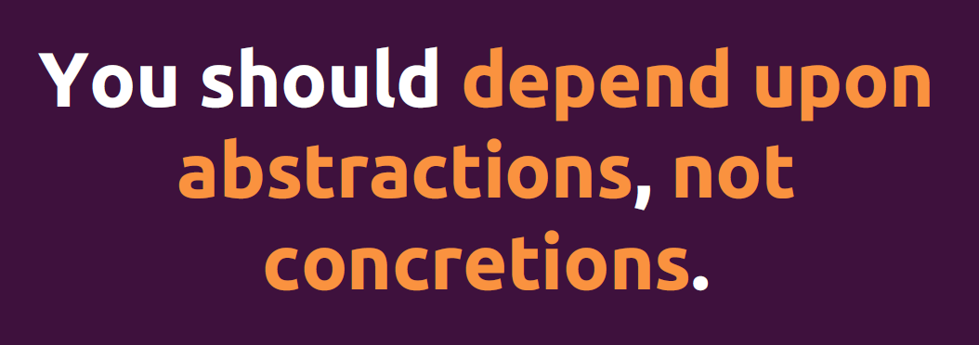
Dependency Inversion Principle

Slide 19
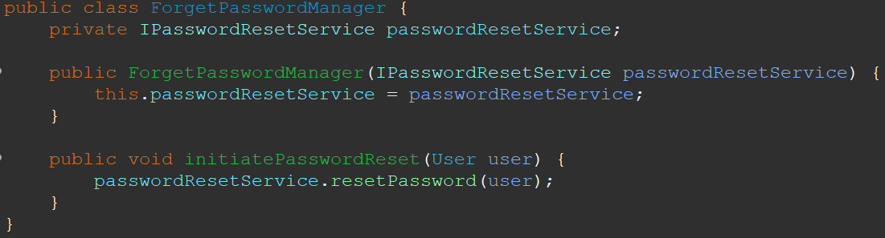

Dependency Inversion Principle

Slide 20
Dependency Inversion Principle
The Dependency Inversion Principle (DIP) is applied in the ForgetPasswordManager class. The ForgetPasswordManager class depends on an abstraction (IPasswordResetService) rather than on concrete implementations.

